Slide 1
RESISTOR,INDUCTOR,CAPACIT0R(RLC)
P.DEVENDAR
CSE-D
24R01A05P9

Slide 2
INTRODUCTION OF RLC:
What is an RLC Circuit ?
An RLC Circuit Is An Electrical Circuit Consisting Of Three Components Connected In Series Or Parallel:
R – Resistor (Opposes Current)
L – Inductor (Opposes Change In Current)
C – Capacitor (Stores Energy In An Electric Field)
These Circuits Are Commonly Used In:
Signal Filtering oscillators radio Tuning Circuits power Transmission Systems

Slide 3

FORMULA:
https://d.docs.live.net/5A97459D22E207CB/%E6%96%87%E4%BB%B6/Desktop/P9.PPTX%20M2.pptx
Mathematically, an RLC circuit is modeled using a second-order linear differential equation derived from Kirchhoff’s Voltage Law (KVL):
L $\frac{d^{2}i}{dt^{2}}+$R$\frac{di}{dt}$+$\frac{1}{c} i=v(t)$
R=resistance
i=current
L=capacitance

Slide 4

PROBLEM:
An condenser of capacity 'c’ discharge through an inductance ‘L’ and resistance ‘R’ in a series and the charge ‘Q’ at time ‘t’ satisfies the equation L $\frac{d^{2}q}{dt^{2}}+$R$\frac{dq}{dt}$+$\frac{1}{c} q=0 given that L=0.25M ,R=250Ω,C=2∗{10}^{−6}$ farads and that when t=‘0’, ‘q’ is 0.002C and the current $\frac{dq}{dt}$=0 obtain the value of ‘q’ in terms of ‘t’
SOL: given D.E is equation L $\frac{d^{2}q}{dt^{2}}+$R$\frac{dq}{dt}$+$\frac{1}{c} q=0$
$m^{2}+1000m+2∗{10}^{−6}$
m=-500$±$1323i
Q=$e^{−500t}(c1cos1323t+c2sin1323t$)
Q=1(c1)
C1=0.002c

Slide 5
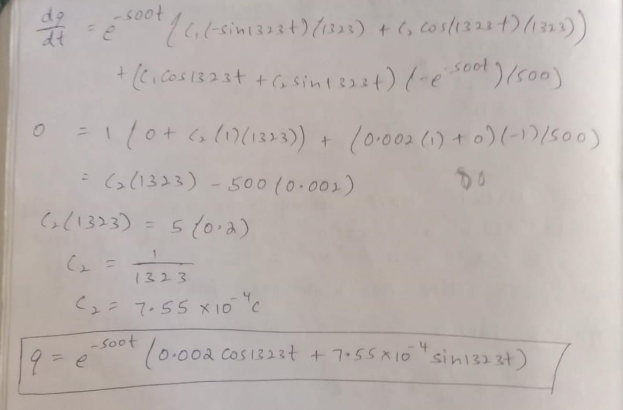

Slide 6
FINAL ANSWER:
Q=$e^{−500t}(0.002 cos1323t+7.55{10}^{−4}sin1323t$)

Slide 7


We analyzed the discharge of a capacitor in a series RLC circuit using second-order differential equations.
$\frac{d^{2}q}{dt^{2}}+1000\frac{dq}{dt}$+${2∗10}^{6}q=0$
The solution showed an underdamped response:
Q(t)=${0.002e}^{−500t}cos1323t+\frac{1}{1323}e^{−500t}sin1323t$)

Slide 8
Thank you

